Slide 1
Food and Beverage Management
Chapter 7 – Standard Product Costs and Pricing Strategies

Slide 2
Planning Menus
Managers must keep in mind target market and financial objectives of the company
After determining price of ingredients – then can figure cost.
Cost then can be translated into price

Slide 3
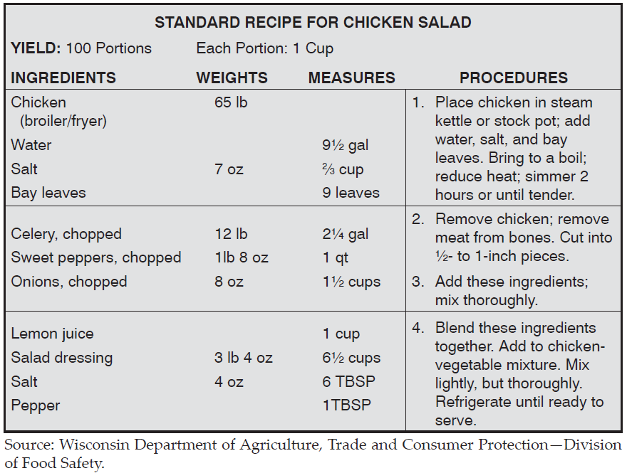
Standard Recipes

Slide 4
Standard Recipes
Most importantly – promotes consistency in
Quality
Flavor
Portion Size
Efficient purchasing practices
More likely the correct amount is prepared
Managers can more effectively schedule people and equipment
Less Supervision is required
Other employees (that can read) can follow recipes
Chefs and Bartenders do not need to be present
Can be computerized!

Slide 5
Recipe Management Software
Maintains 3 critical files
1. Ingredient File
2. Standard Recipe File
3. Menu Item File

Slide 6
Ingredient File
Contains data about each purchased ingredient
Purchase unit ( ex. 50 lb case of shrimp in 10 (5 lb) Boxes
Issue Unit (ex. 5 lb box and cost per unit issued)
Recipe Unit ( ex. 3 lbs shrimp)
Some files may have more than 1 recipe unit – sliced bread vs. breadcrumbs

Slide 7
Standard Recipe File
Contains Recipes for all menu items
Easily scalable to yield desired quantities
May contain subrecipes
The inclusion of subrecipes in Standard files is called ”Chaining Recipes”

Slide 8
Menu Item Files
Used primarily by POS system
Contains:
Recipe Code number
Selling Price
Ingredient quantities
Sales Totals
Usually contain item’s sale history

Slide 9
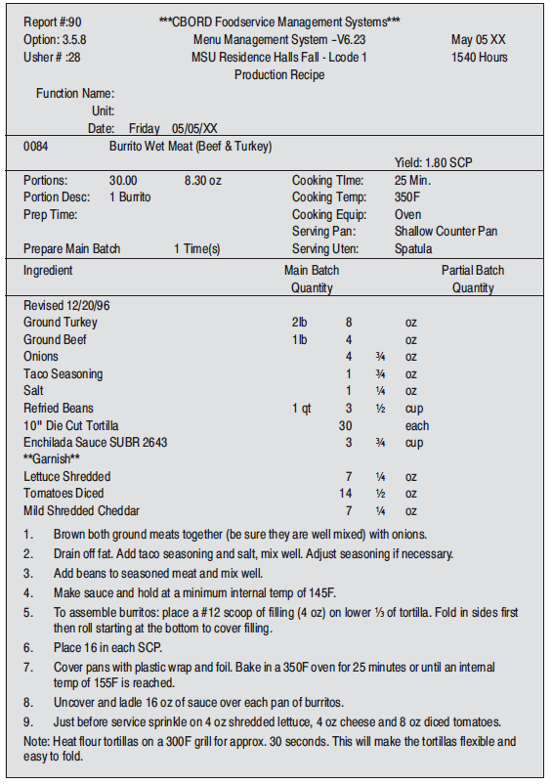
Computer Generated Recipe

Slide 10
Developing Standard Recipes
Requires standardizing existing recipes –
Develop implementation schedule
Talk through preparation -
How much of each ingredient?
What are exact procedures?
Cooking/Baking Times?
What portion control tools are used?
Garnishes?

Slide 11
Developing Standard Recipes
Use standard format
Establish desirable yield
List all ingredients in order used
Weights or Measures? Weights are more accurate
Express quantities in practical amounts
Record Procedures in detailed terms
Provide Directions for portioning

Slide 12
Pre-Costing and Adjusting the Recipes
You’ve got to know your weights and measures!

Slide 13
Developing Standard Recipes
TEST THE RECIPE!!!
Minor changes/fluctuations can make big differences
Baked items - changes in altitude or humidity
Make sure everyone is in line with the program
Make sure ingredients are available
Review popularity and ease of use with customers and staff.

Slide 14
Adjusting Standard Recipe Yields
Yield can be increased or decreased using an Adjustment Factor
Adjustment Factor = Desired Yield
Original Yield

Slide 15
Adjusting Standard Recipe Yields
Example:
Adjustment Factor = 225 portions (desired) = 2.25 100 portions (original)
Multiply adjustment factor and original recipe amount
New amount = 8 oz. X 2.25 = 18 oz

Slide 16
Adjusting Standard Recipe Yields
Same methodology is used to determine portions and volumes:
Desired Portion = Adjustment Factor
Original Portion
Recipe yields (40) 12 oz portions – (40) 8 oz portions needed
8 oz = 0.67
12 oz
Recipe original amount was 20 lbs
20 lbs X 0.67 = 13.4 lbs

Slide 17
Adjusting Standard Recipe Yields
Taste test – not as simple as math!
Modify recipe until it yields desired volumes
Adjust the recipe to provide portions for a specific pan size – then make it to the number of pans needed

Slide 18
Determining Standard Portion Costs
After Standard Recipes and portion sizes have been established, costs can be determined
Standard portion cost is the cost to produce one portion of an item according to the standard recipe
Meal Cost – is the total of all items included in the meal

Slide 19
Determining Standard Portion Costs
Is determined by dividing the sum of the ingredient costs by the number of portions
If cost is $75 and yields 50 portions –
Standard portion cost is $1.50

Slide 20
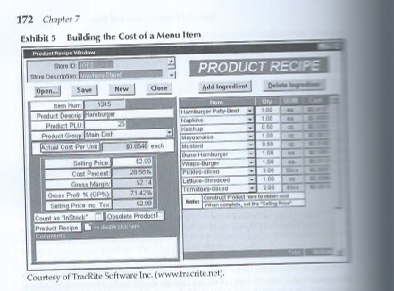
Determining Standard Portion Costs

Slide 21
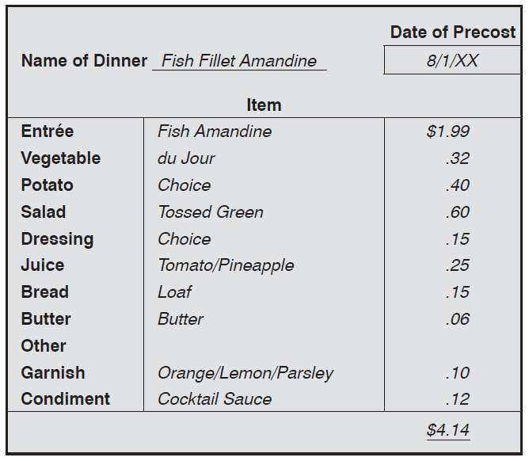
Standard Recipes & Costs

Slide 22
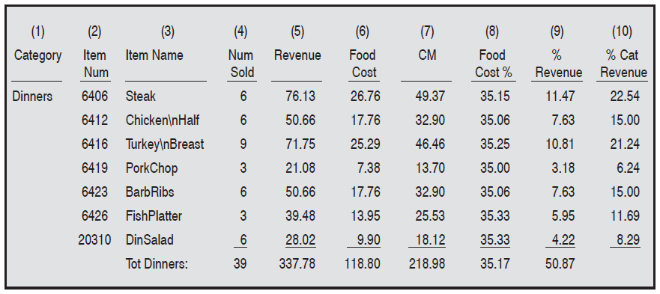
Determining Overall Standard Food Costs

Slide 23
Determining Overall Standard Food Costs
Ideal Food Costs can be calculated
Compare Theoretical to actual
Bottom line profit is reduced by $1 for each $1 in higher food cost
Low than anticipated needs investigation as well

Slide 24
Portion Costs for Beverages
Usually simple – few ingredients
Most alcoholic beverages are sold by the liter
Some need to convert liters to ounces
33.18 oz to 1 liter
Cost per oz = price per bottle (unit)
Ounces per bottle
Drink Cost % = Drink cost
Selling Price

Slide 25
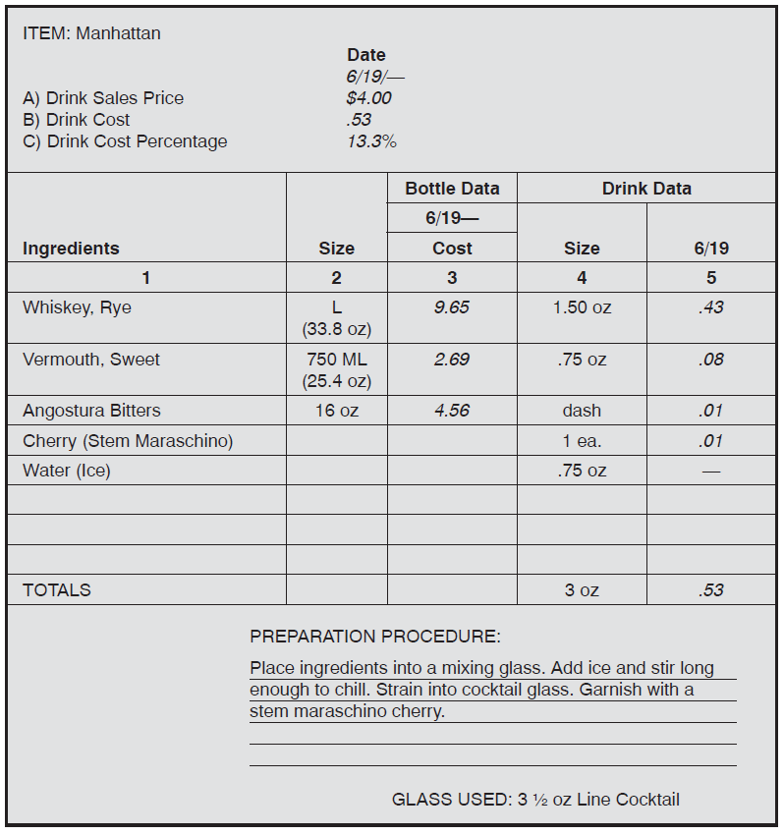
Beverage Cost Calculations

Slide 26
Pricing Menu Items
Art of Pricing – intuition
Reasonable Price Method – “If I were a guest – how much would I pay for this?
Highest Price Method – go in high and back off
Loss Leader Price Method
Intuitive Price Method – WAG!

Slide 27
Pricing Menu Items
After determining desired food cost %
Selling Price = Standard portion cost
Desired Food cost %
ex. 1 portion cost = $1.50, desired food cost % = 33%
$1.50 = $4.55 (rounded)
.33

Slide 28
Pricing Menu Items
Elasticity of demand – relationship between selling price and demand
Is Lower Food Cost % always the goal?
Consider contribution Margin

Slide 29
Pricing

Slide 30
Profit Pricing
Profit Pricing method ensures that profit requirements and non food expenses are considered
Allowable Food Cost = Forecasted Revenue – nonfood expenses – profit desired
Calculate Budgeted Food Cost %
Budgeted Food Cost % = Allowable Food Costs
Forecasted Food Revenues

Slide 31
Pricing Menu Items
Example -
Forecasted Food Rev. – Non Food Exp – Profit Target = $310,000
$800,000 - $415,000 - $75,000
Allowable Food Cost $310,000 = .388 (39 % rounded)
Forecast Food Rev. $800,000

Slide 32
Final Word
Know your Market
Know your Competition
Elasticity of Demand – how price changes in response to demand.

